Slide 1

Angle Forward with TypeScript
Jeremy Likness (@JeremyLikness)
Director, Application Development
iVision http://bit.ly/ivisionappdev
Blog http://bit.ly/coderblog
Migrating ng1 to ng2

Slide 2

In the Next 20 Minutes …
Why TypeScript?
Three Approaches to Upgrading and/or Migrating
Hands-on Example
Conclusion

Slide 3
Why TypeScript?
It’s what the Angular 2 team is using: http://typscriptlang.org/
Makes the module question easy to answer (AMD, CommonJs, SystemJs, etc.)
Superset of JavaScript
Targets ES5, ES6/ES2015, etc.
Types, Interfaces, Classes, Modules, Function Definitions, Generics, Declarations and Decorators
Type Libraries / Visual Studio Code

Slide 4
Three Approaches to Upgrading/Migrating
Big Bang – all at once (upgrade case study: http://bit.ly/ngupgcase)
ngForward – tomorrow’s format, today
ngUpgrade – piecemeal or side-by-side
* Note: lose $scope and $watch. Controller As if you please.
Prepare
Bootstrap
Upgrade
Downgrade
Migrate

Slide 5
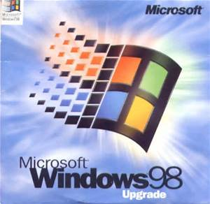
Demo
Let’s upgrade!

Slide 6
Quick Reference
[service, factory, value, etc.] => provide and/or resolveAndCreate
Directives -> Directives or Components
Components have UI, directives may just be behavior
Controllers -> Components
Services -> Services
Filters -> Pipes

Slide 7
What’s next?
Full upgrade case study: http://bit.ly/ngupgcase
Controller As: http://bit.ly/ngctrlas
Twitter: @JeremyLikness
Blog: http://bit.ly/coderblog
GitHub: https://github.com/jeremylikness
Special Offer: Introduction to Angular 2 with TypeScript
http://bit.ly/ng2video
Promo Code LIKNESS-16 for free trial (no credit card required)
Reach out to me anytime! jlikness@ivision.com
QUESTIONS?

